Slide 1
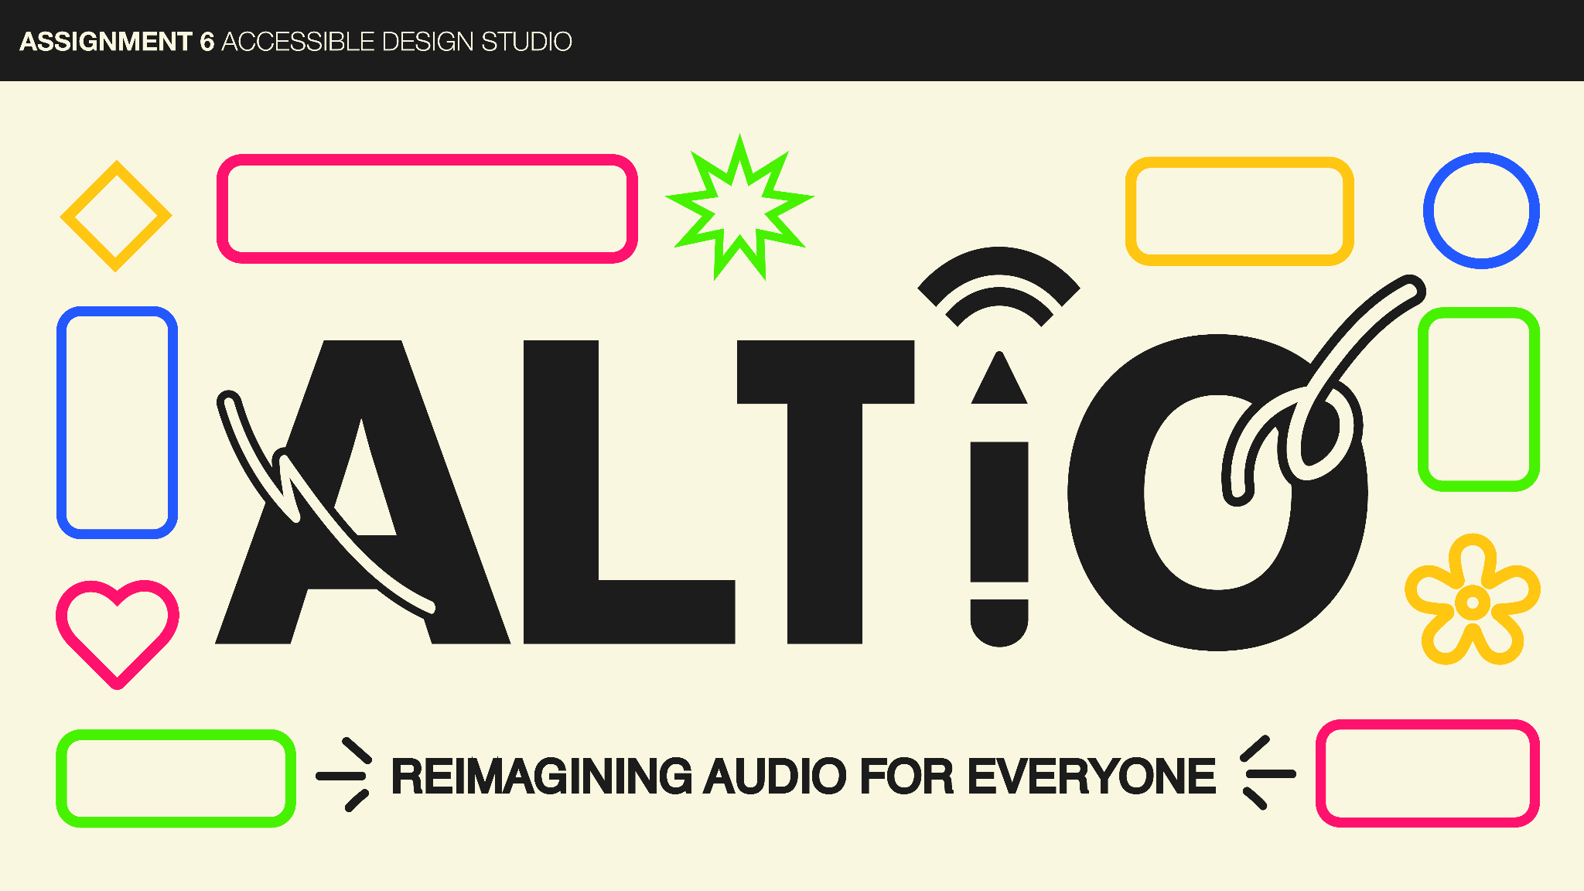
6

Slide 2

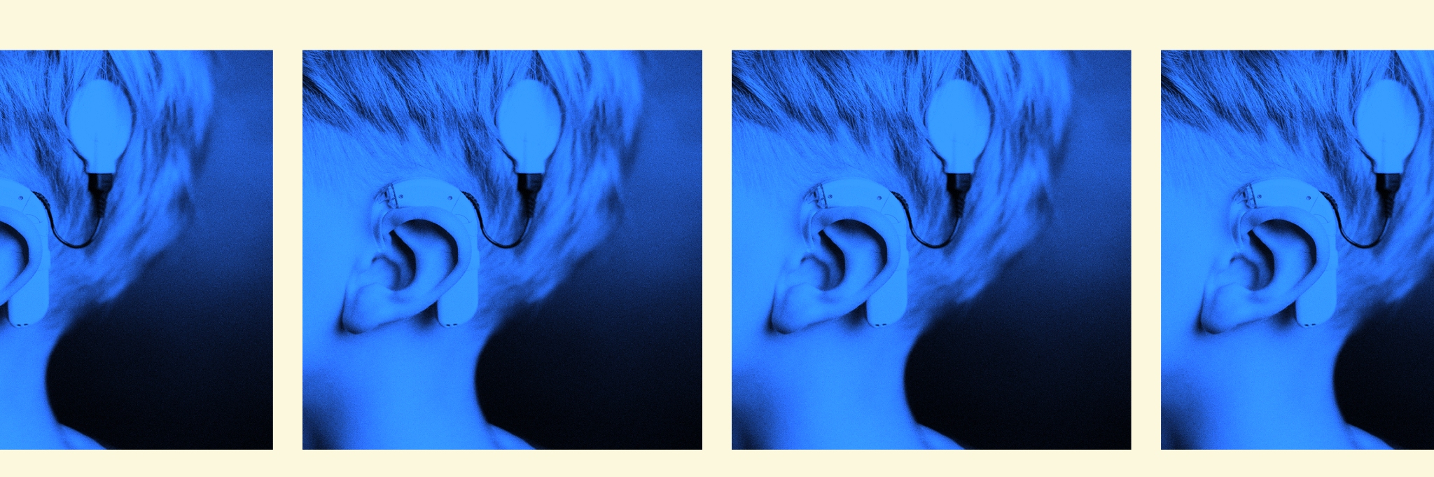
Reimagining audio for everyone.
Problem
Solution
Deaf and hard of hearing people are often are left out of key nuanced information that is conveyed through audio in digital spaces
ALTiO is a social media platform that encourages and provides drawings as visual supplements for interpreting audio–providing alternative options for everyone to experience content

Slide 3
VALUES ENCODED
Values
Inclusion: ALTiO’s intention is to include everyone in fully experiencing digital content, especially those in the Deaf/HoH communities, who are often excluded from audio–often a large part of this content form.
Creativity: We want to encourage all to participate and to create something and express themselves.
Design
Features
Including captions on all content and allowing posters to edit incorrect captions.
Drawing interpretations are up to the interpreter, and they essentially have free reign over what to create.
Conflicts
Including everyone in the posting process while still providing audio interpretations to users
Allowing everyone regardless of drawing ability to participate
Empowering people to create while maintaining respect and being helpful in the interpretation process

Slide 4
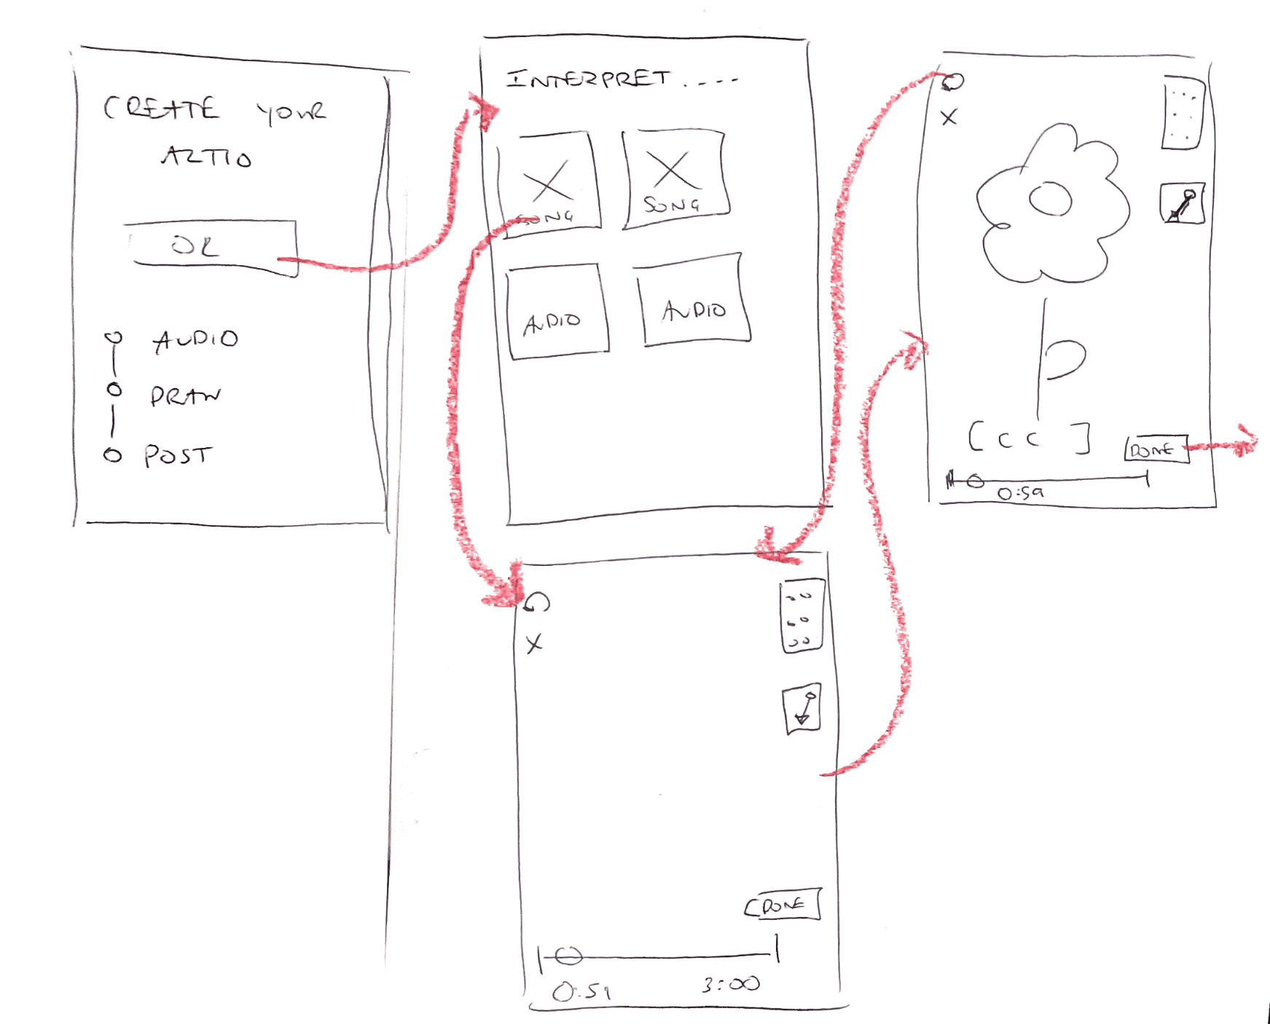
SIMPLE TASK:
Interpret an audio
The user follows prompts to create a post and add a drawing.
low-fi
The main change from the low-fidelity prototype is that anyone can participate in posting by allowing content without audio to be included, with or without an interpretation.

Slide 5
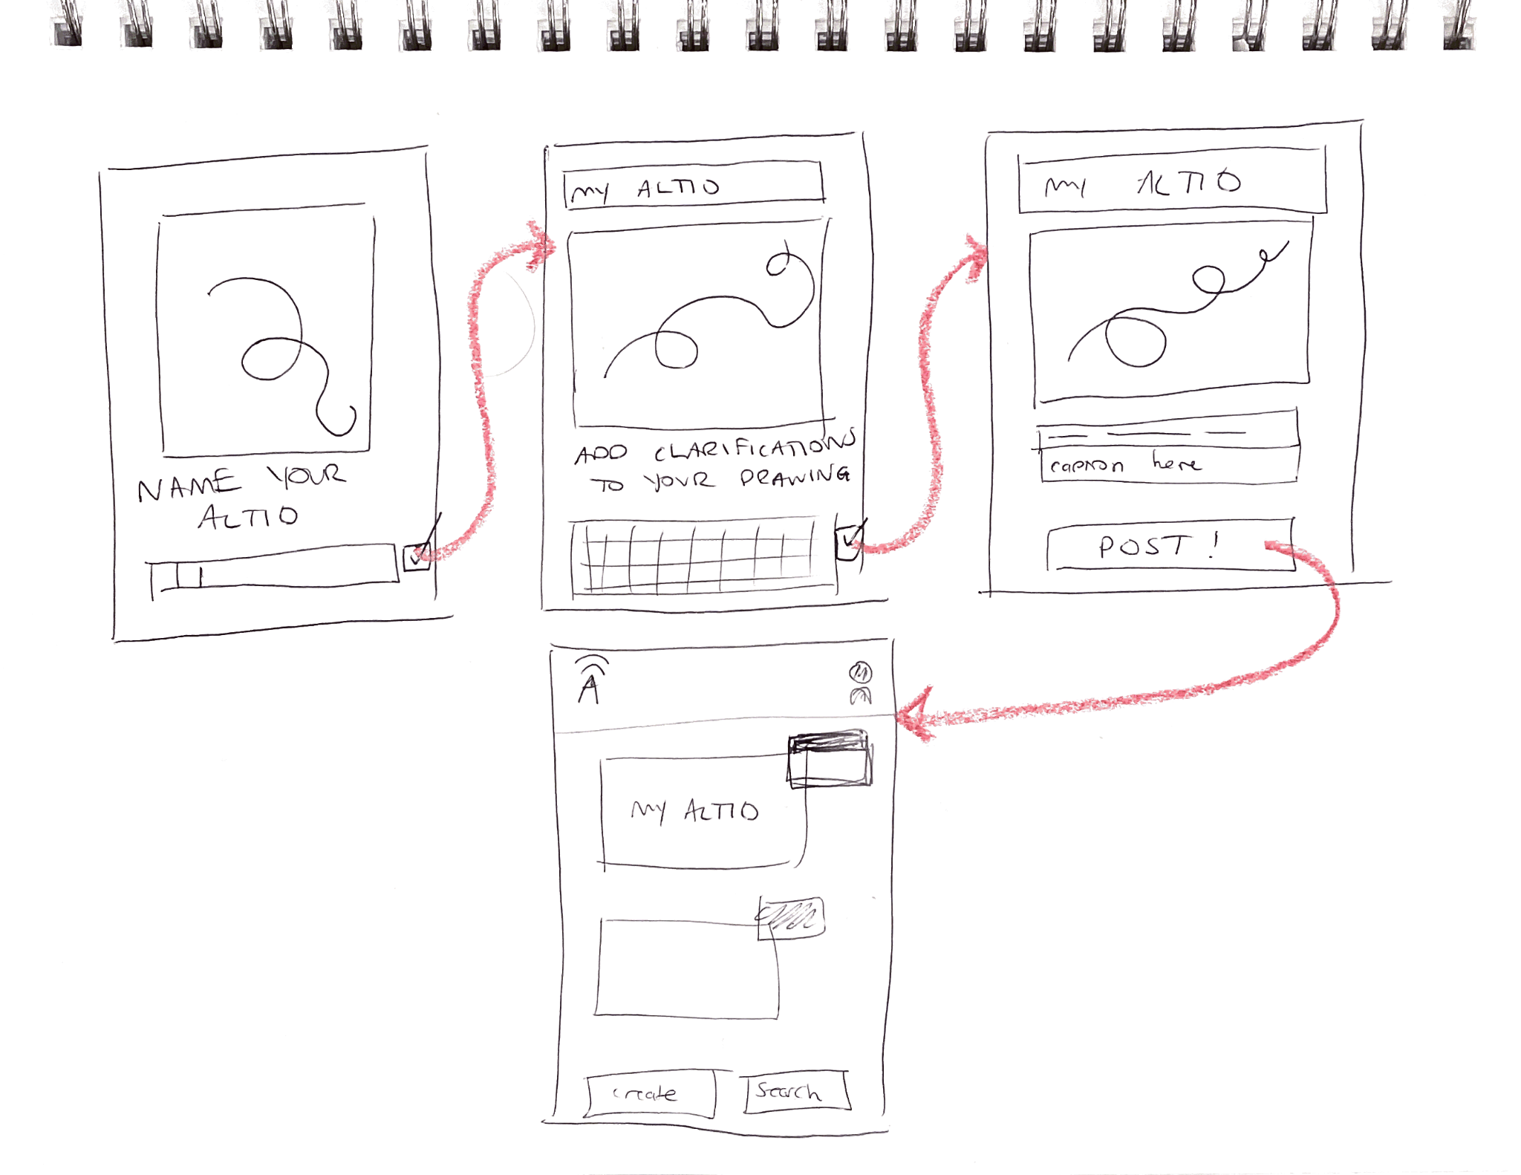
MODERATE TASK:
Explain and clarify interpretation
The user follows the prompts to name their ALTiO, add captions, and annotate with explanations.
low-fi
The main change in task is that explanations will now have a tap-to-annotate functionality rather than just writing captions below the post.

Slide 6
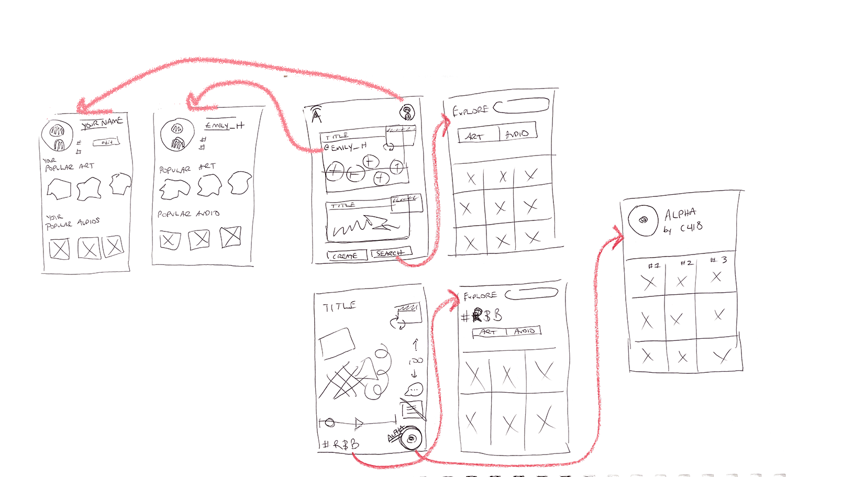
COMPLEX TASK:
Interact with various interpretations and artists on the platform
The user explores different social content in the app, such as the profile pages, hashtags, and posts in the feed.
low-fi
Now when exploring audio, users can see tags for the vibe and typical drawing features associated with each audio.

Slide 7
Usability Goals & Key Measurements
Usability Goal 1: Discoverable
Usability Goal 2: Enjoyable
Goal
User taps into many different features, and has minimal questions in performing task
Learning curve is manageable
User shows or voices signs of excitement/enjoyment
Progress
We need to streamline the onboarding flow so users can understand the purpose of our app and how to create a helpful ALTiO.
Label key features and buttons for convenience and clarity
Introduce fun color and background elements to make the app feel artistic and engaging

Slide 8
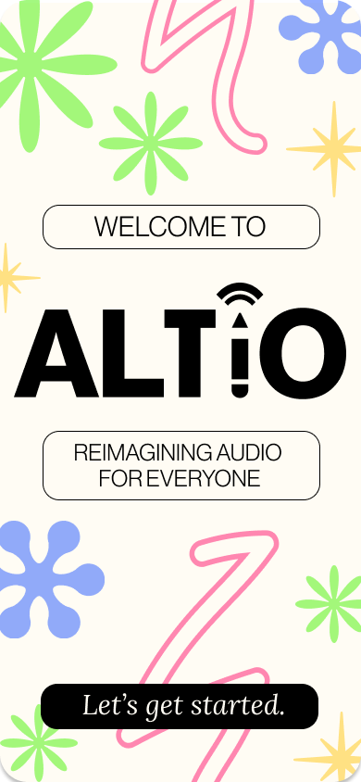
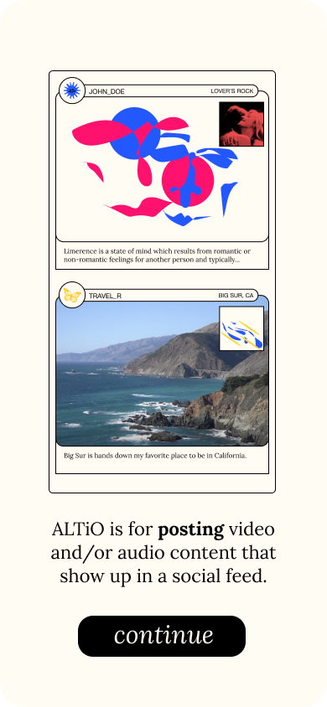
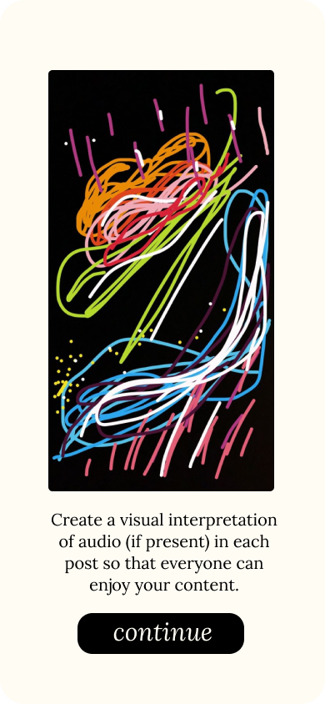
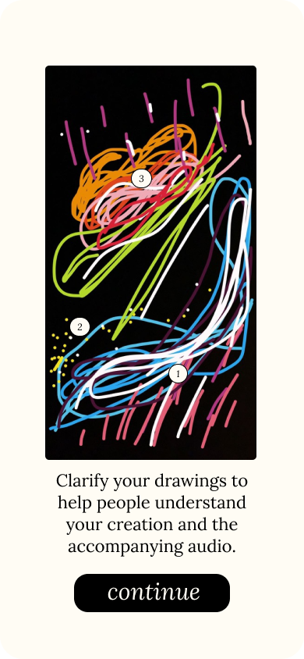
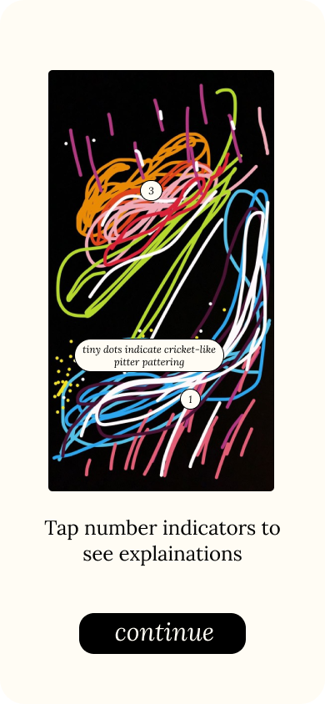
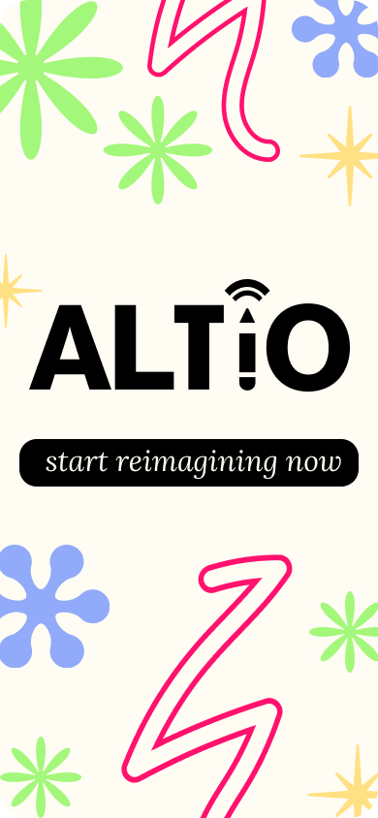
Revised Interface Design
MAJOR DESIGN CHANGE 1 - Onboarding Flow
From low-fidelity prototyping, it took one of our users around 15 minutes to understand the purpose of our app.
med-fi:
low-fi:
[NONEXISTENT]
SOLUTION: Create an onboarding flow to inform users of the purpose and ease user into unique features.
Notes:
No “before,” considering that it was newly added. We needed to add this clarification because many users who had no experience with the app took a long time to figure out what exactly the purpose of the app was.

Slide 9
Revised Interface Design
MAJOR DESIGN CHANGE 1 - Onboarding Flow
Explain the concept of an ALTiO (alternative audio)
Explain ability to click to expand explanations on drawing
Explain the main function of the app (social media)
Show the process of adding clarification for drawings
Notes:
Onboarding screen is colorful and sketch-like to emphasize creativity.

Slide 10
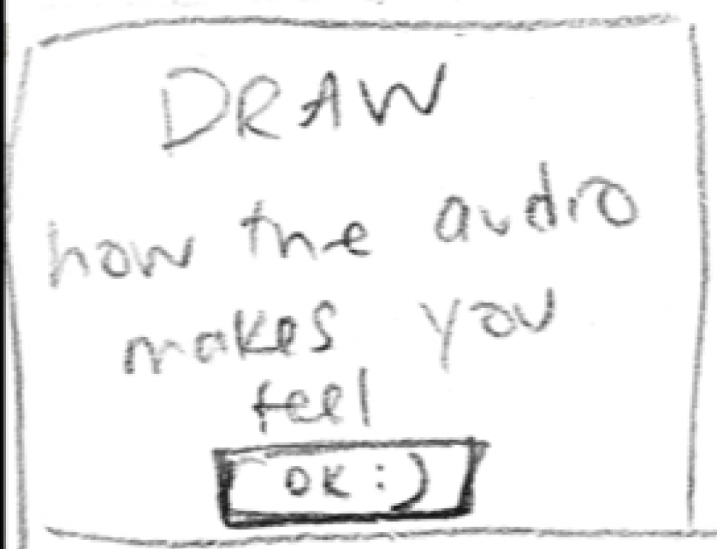
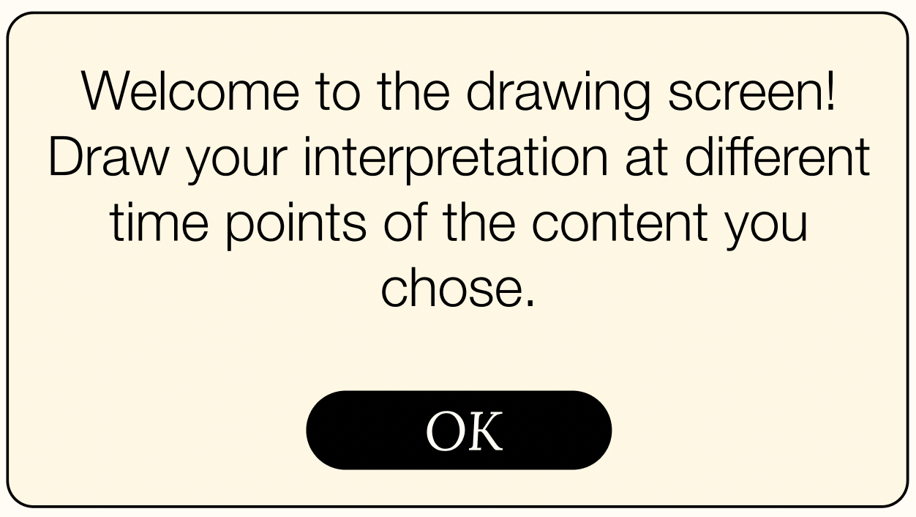
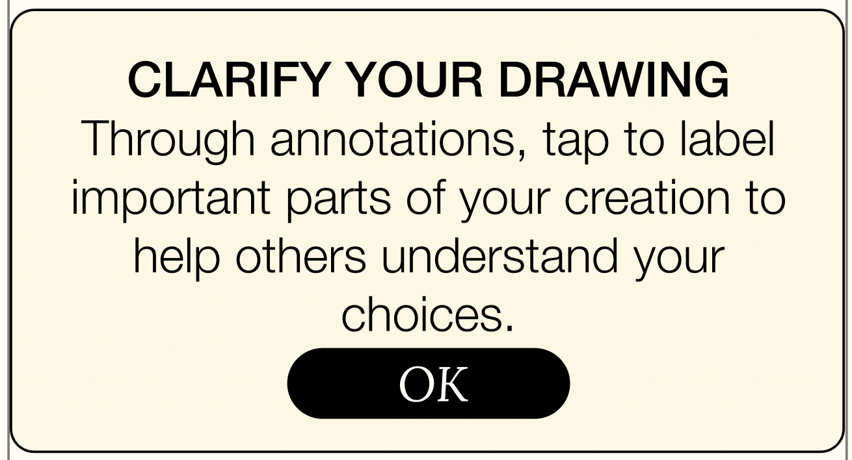
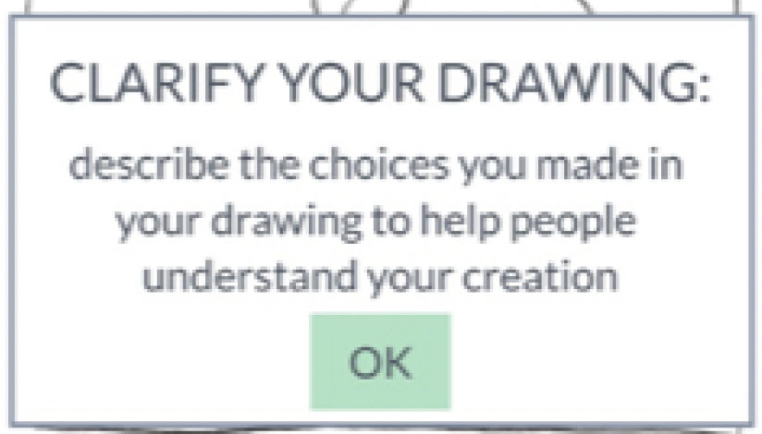
Revised Interface Design
MAJOR DESIGN CHANGE 2 - Revised Clarifications
For some participants, directions were not fully clear around the purpose of the drawings or explanations.
low-fi:
med-fi:
Clarity on the purpose of drawings and clarifications is essential to the inclusion aspect of the app–as we want to keep the interpretations both creative and beneficial to users. These encouragement pop-ups seek to emphasize key features (such as scrolling through the timeline, and adding annotations) that allow users to add depth to their interpretations.
SOLUTION: Revise clarifications to make clearer how and what the drawings should accomplish.

Slide 11
Revised Interface Design
MAJOR DESIGN CHANGE 2 - Revised Clarifications
We wanted to emphasize that users can draw interpretations at different time points.
This instruction was vague for many participants - the lack of guidance may make people confused about how to draw their interpretation.
This pop-up failed to explain how users might annotate to clarify their drawings.
This pop-up clarifies how users might label their drawings and what information to include.

Slide 12
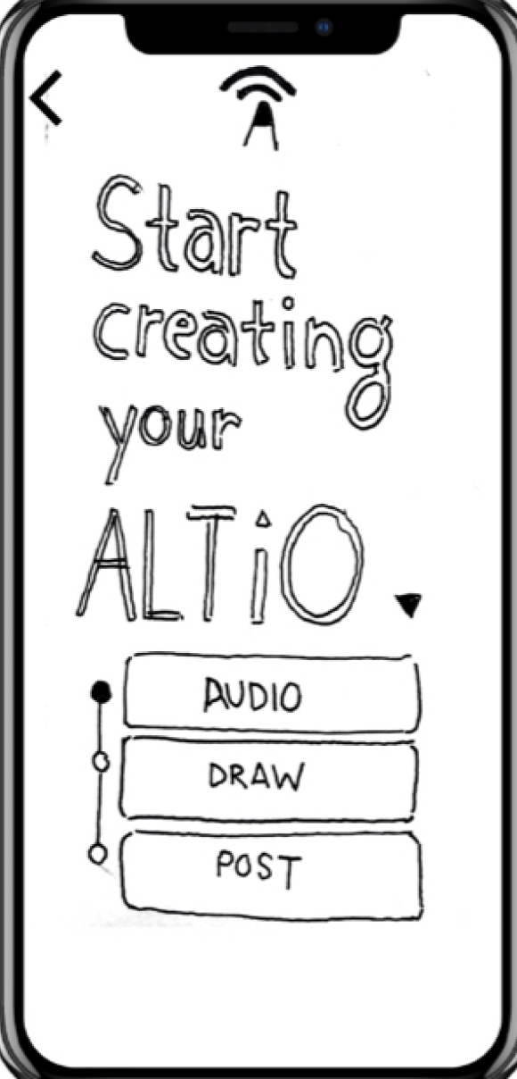
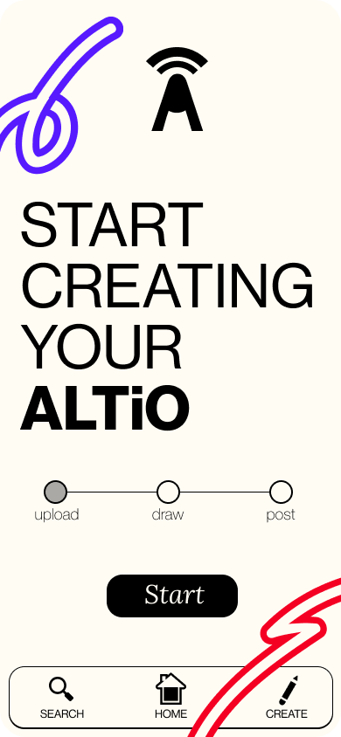
Revised Interface Design
MAJOR DESIGN CHANGE 3 - Starting Creation Screen
For our Deaf participant in particular, in starting the posting process, she was concerned about clicking on the word “audio”. Other users were confused about which buttons were clickable.
low-fi:
med-fi:
SOLUTION: Change content uploading flow - make the start screen more intuitive by changing buttons, allow for different types of content to be uploaded to allow all to participate.

Slide 13
Revised Interface Design
MAJOR DESIGN CHANGE 3 - Starting Creation Screen
We changed the starting screen to look more like a progress bar, and through having a single button, we made it clearer where to click in order to start the posting process. This progress bar is present on other screens in the posting process to make clear where they are in the process.
Our Deaf participant was concerned about choosing “audio”.
Participants were frequently confused by the design on this page - “audio” is the starting point, and the only one users can click on, however “draw” and “post” both look like clickable buttons.
“Audio” is replaced with “Upload” so that content is not limited to audio, and for ease of mind for participants.
Notes:
This progress bar looks like a bar now and not a set of buttons. We changed it to be horizontal to clarify the process of creation, make sure that users were not frustrated with the new type of posting ALTiO offers, and to indicate where exactly in the process they were.

Slide 14
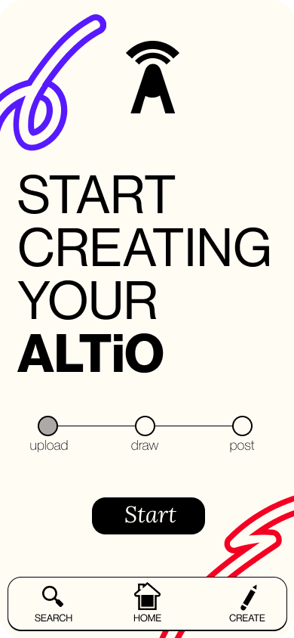
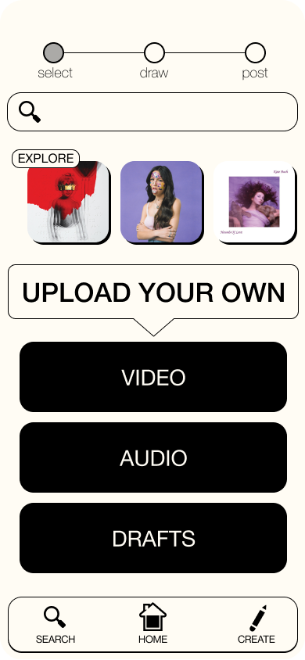
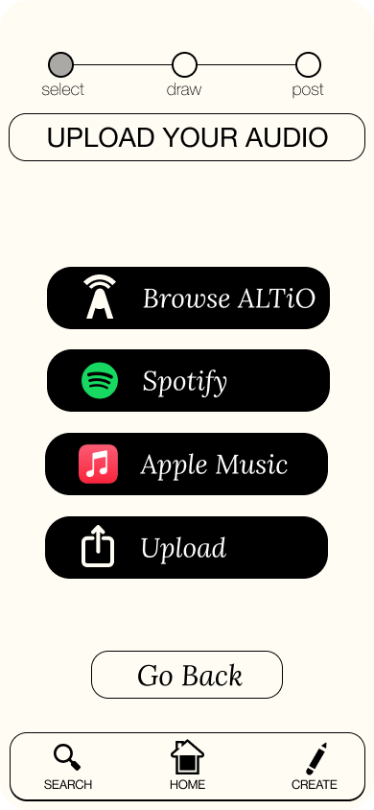
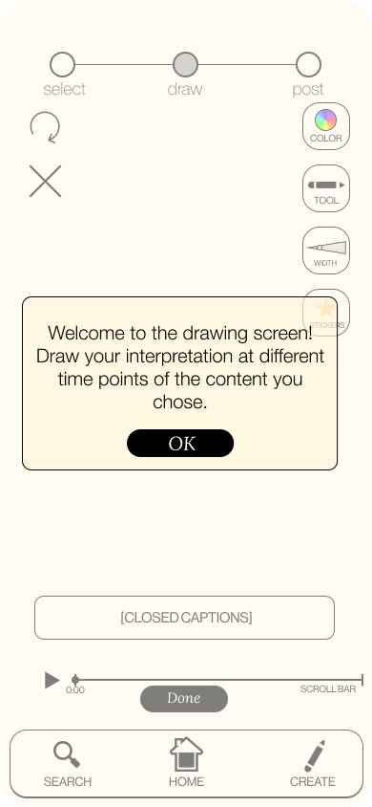
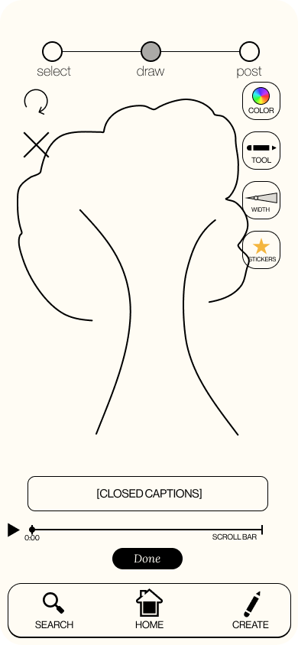
Revised Interface Design
Drawing screen to draw interpretation, different pickers to change color, tool, thickness, or to include stickers.
Audio can be uploaded from different sources, or chosen from the existing audios in ALTiO.
SIMPLE TASK: Interpret audio
Some screens are missing for space concerns, but this is the overall flow.
Stickers and other presets are included for users who may not be as comfortable with drawing but still want to participate in the app experience.
Drag scroll-bar to move to different timestamp to create new drawing at different timestamps.
Video and or audio can be uploaded, or continue posting from a draft saved.

Slide 15
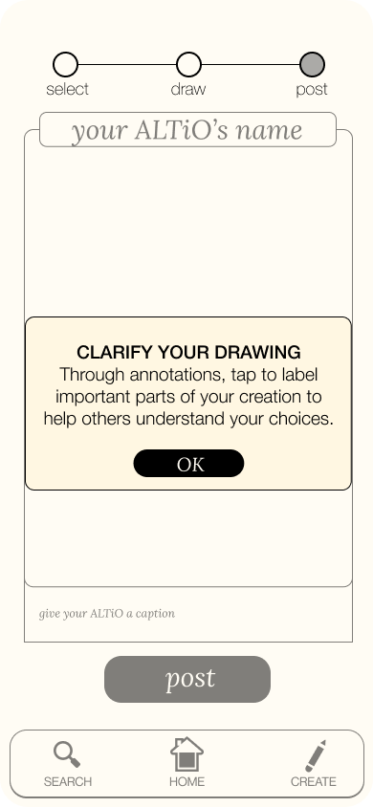
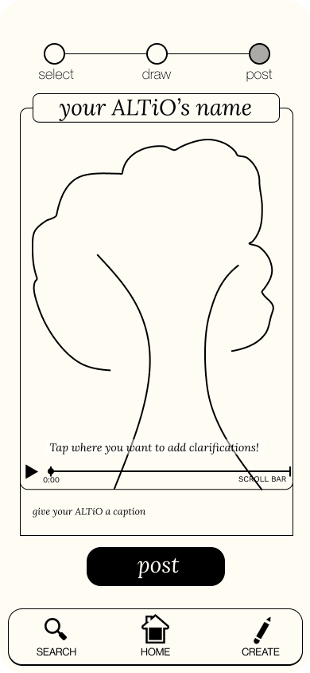
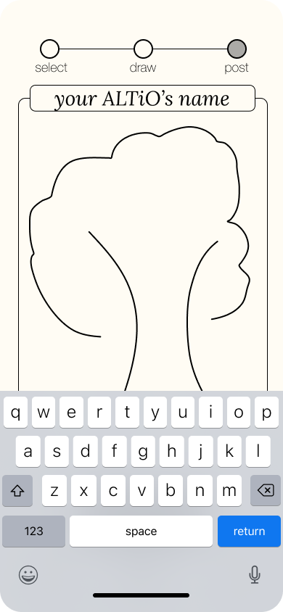
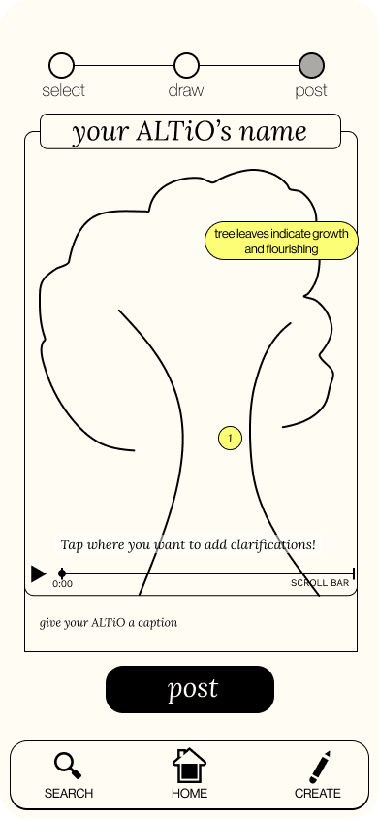
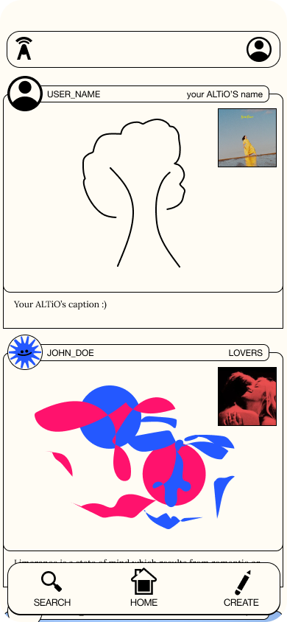
Revised Interface Design
MODERATE TASK: Explain and clarify interpretation
Illustrating the UI of how clarifications showed up was key in this prototype, as it is something we left out of the last prototype, and is quite important to the clarity and usefulness of the interpretations.
The posted ALTiO is now in the social feed.
Users can add the ALTiO’s name, clarifications, or caption by tapping.
The scroll bar allows for clarifications to be written for different time points.
Clarifications show up after tapping the screen and typing them (click to open and close)

Slide 16
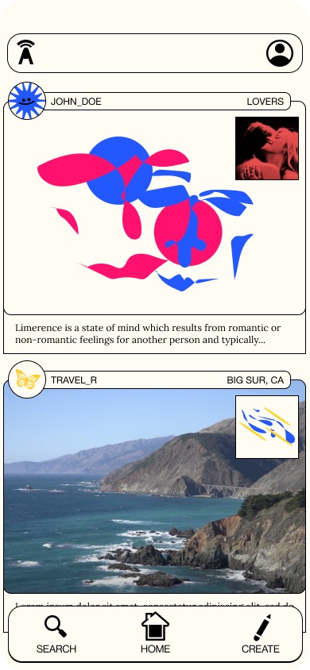
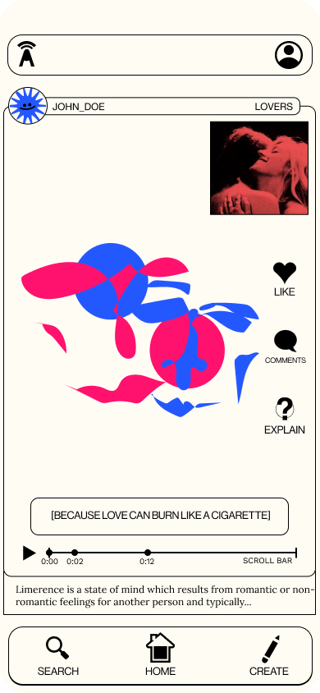
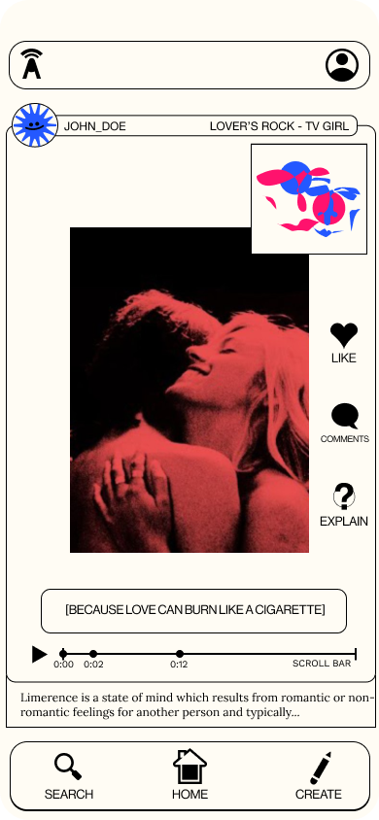
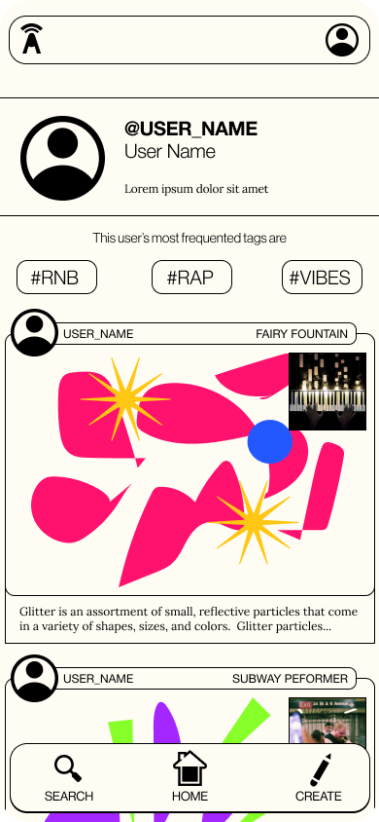
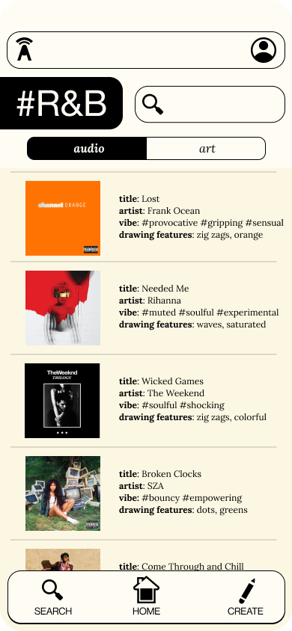
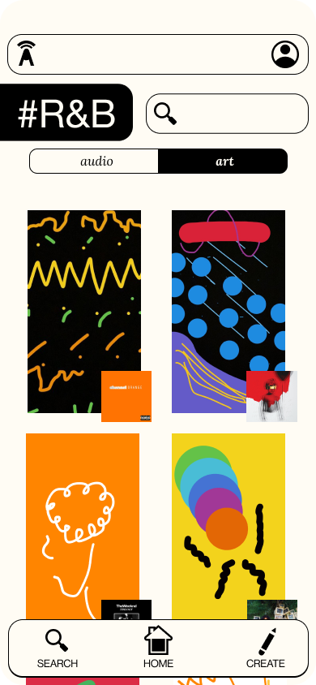
Revised Interface Design
COMPLEX TASK: Interact with various interpretations and artists on the platform
Tap to switch between video and drawing
Switch between audio and art at the explore page
Tap to toggle explanations
Users can navigate to explore pages either by searching or by tapping hashtags.

Slide 17

Prototype Overview
Design/Prototyping Tools
Figma was our primary design and prototyping tool.
CONS
None of us had a ton of familiarity with Figma
Somewhat steep learning curve
Limitations in drawing and audio content for prototyping
PROS
Plenty of resources (class workshops, online tutorials)
Interactive component functionality
Collaborative workspace, easy to work in as a group
Components and styles to make styling consistent

Slide 18
Prototype Overview
Limitations/Tradeoffs
Lack of content - posts, profiles, audio, music
Figma lacks drawing features and audio playback for prototyping
Users cannot upload their own content directly
Not all buttons are clickable due to constraints on time and space available
Between the four audio options, only the “Browse ALTiO” button is clickable here, as we could not connect Spotify or Apple Music to our prototype.

Slide 19
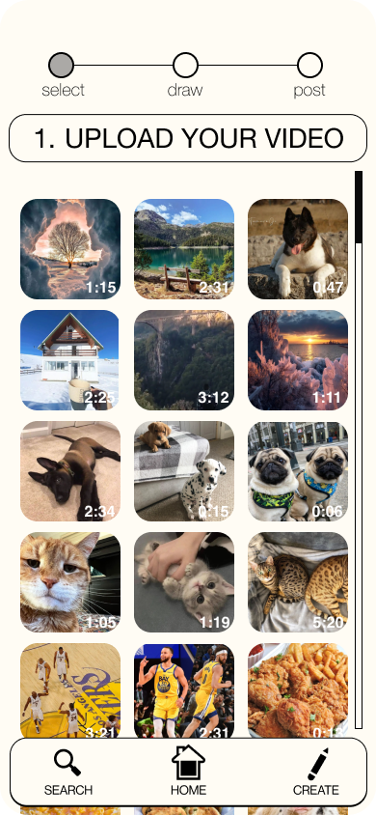
Prototype Overview
Wizard of Oz Techniques
For uploading audio, users will pretend to upload their own content as this functionality is not available in Figma.
The “drawing” takes the user through a series of screens where a pre-drawn interpretation is created by tapping through.
For prototyping, we would play audio while users interpret.
Uploading video content pulls up fake video thumbnails that are meant to be the user’s.

Slide 20
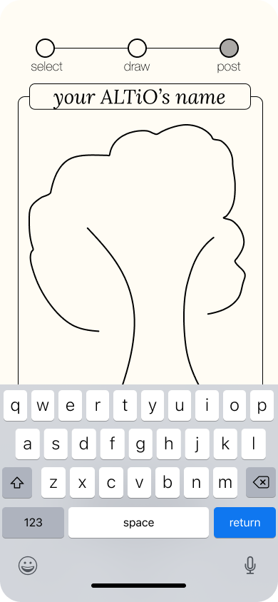
Prototype Overview
Hard-coded Features
As there is no user content nor a database, all user and post related content is hardcoded.
The explore audio section and recommendations of audio/drawing are also hardcoded as we are limited in time and scope.
Typing in information is hardcoded (captions, titles, clarifications)
Typing pulls up this keyboard, but nothing typed is actually recorded

Slide 21
PROTOTYPE LINK
MEDIUM FIDELITY PROTOTYPE

Slide 22
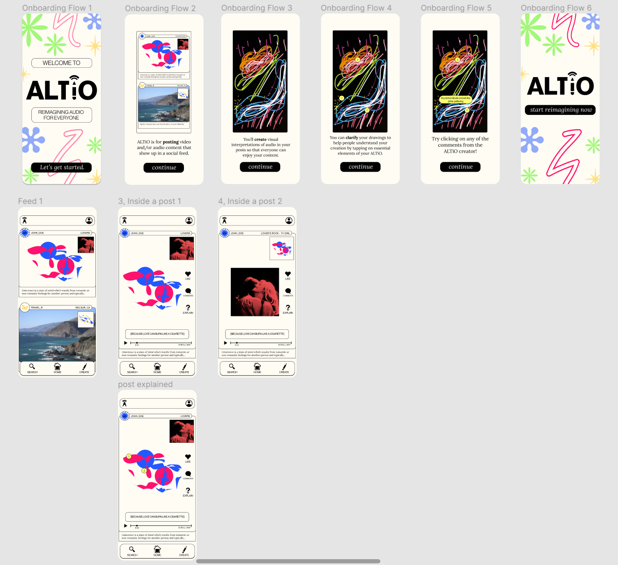
APPENDIX
Onboarding Flow
Post Flow

Slide 23
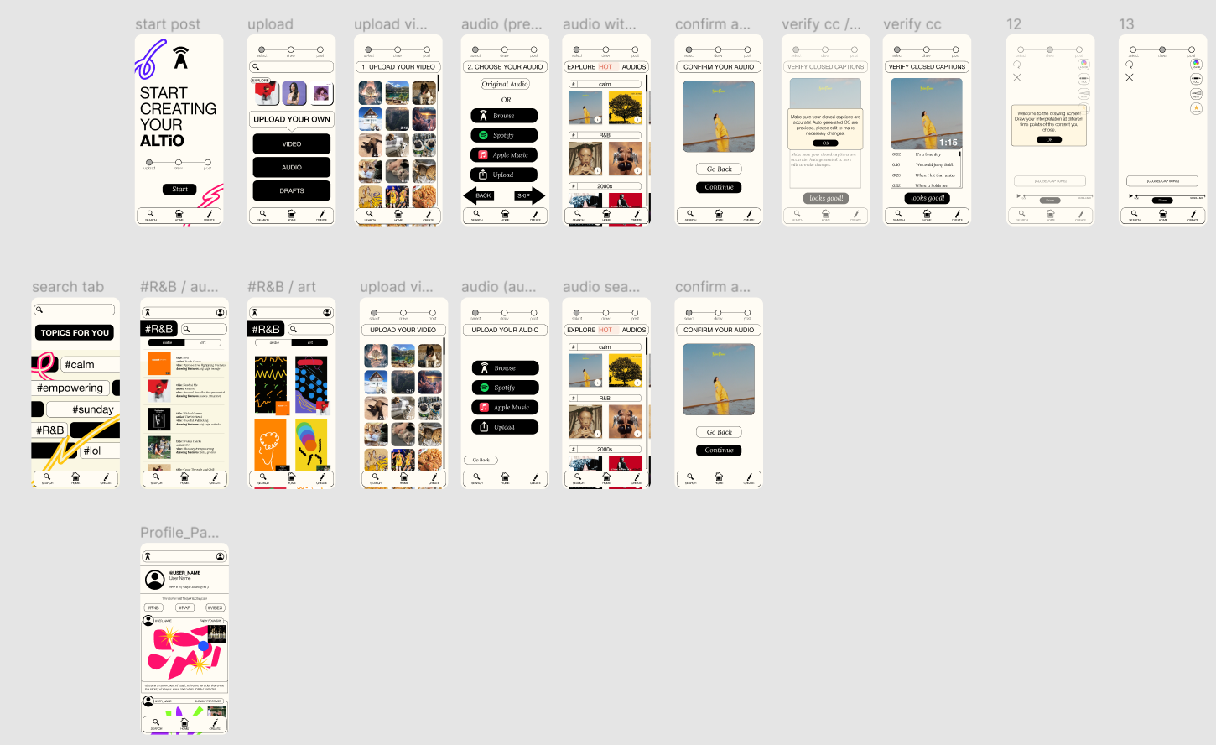
APPENDIX
Create Post Flow
Explore Flow
Profile page

Slide 24
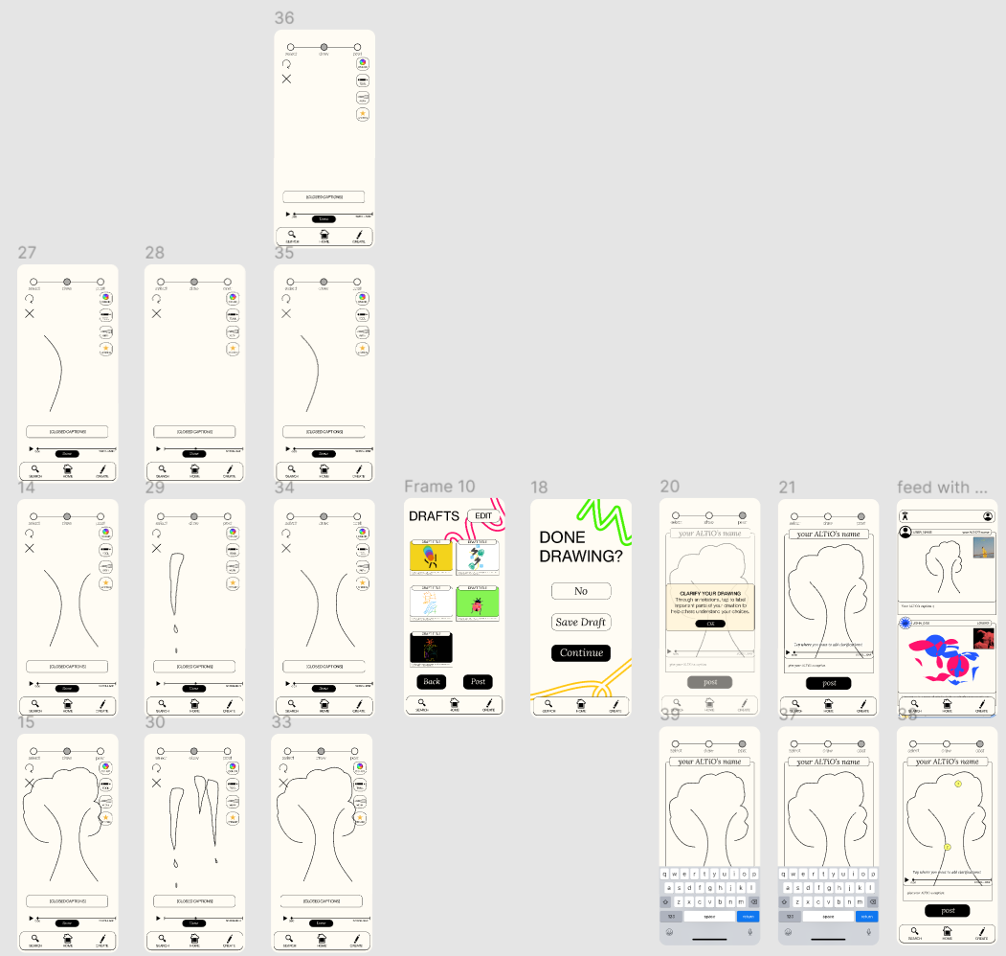
APPENDIX
Creating Interpretation Flow

